Slide 1

Driver’s Drowsiness System
Batch No: B-08 Project Guide:
N. Pragathi (164G1A0568) Mr. M. Narasimhulu., MTech,.
K. Praneetha (164G1A0569) Assistant Professor.
B. Raveena Sai (164G1A0578)
Y. Sreedhar Jaswanth (164G1A05A1)
S. Vijay Kumar (164G1A05B7)
GitHub link:https://github.com/Pragathi568/Drivers-Drowsiness-System
Srinivasa Ramanujan Institute of Technology
Department of Computer Science & Engineering

Slide 2
Contents
Introduction
Existing System
Proposed System
Requirements
Problem Definition
UML Diagrams
Implementation
Outputs
Conclusion
References

Slide 3
Introduction
According to a study, around quarter of the motor vehicles accidents occur due to sleepiness and tiredness while driving long distances, to the driver.
The main idea of this project is to develop an system which ensures safety of the driver by monitoring the status of the driver’s eye from a camera and alerting him whenever necessary.

Slide 4
Existing System
The existing system detects the full face which follows RGB colour format, which takes more time to detect the drowsiness and alert.
So the occurrence of accidents will be more due to the time delay.

Slide 5
Proposed System
The proposed system will alert the driver by taking an input from an live video, mainly focusing on the eyes and by changing the colour format from RGB to Gray .

Slide 6
Requirements
Software Requirements:
OS : Windows.
Python IDE : python 3.x.x
Module : OpenCV & which are needed.
Hardware Requirements:
RAM : 4GB and Higher.
Processor : Intel i3 and above.
Hard Disk : 320MB: Minimum.

Slide 7
Problem Definition
The present existing system has the problem in detecting & alerting the driver drowsiness by processing the full face in RGB colour format. The proposed method uses ‘OpenCV’, ‘NumPy’ and other packages for the detection of drowsiness by processing only the eyes which has to be mainly focused and by converting the video into “grey scale” to have a better performance.

Slide 8
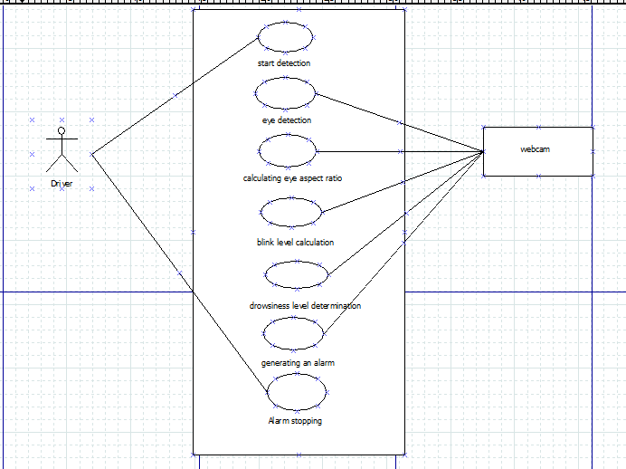
UML Diagrams Use case Diagram

Slide 9
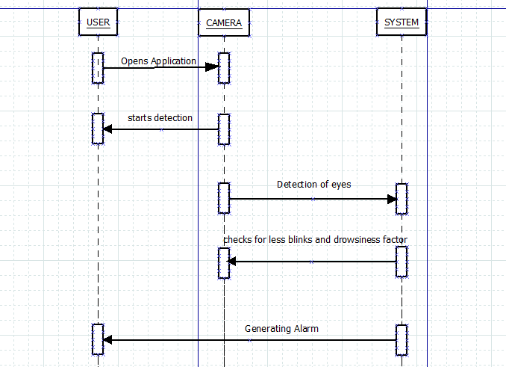
Contd..
Sequence Diagram

Slide 10
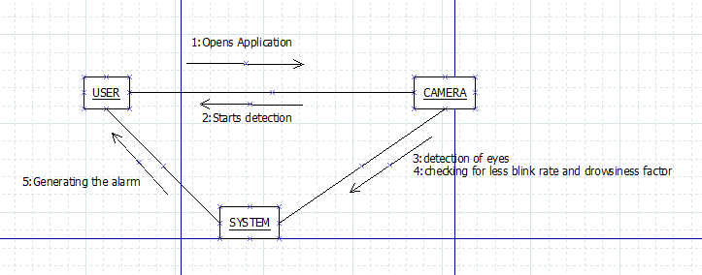
Contd..
Collaboration Diagram

Slide 11
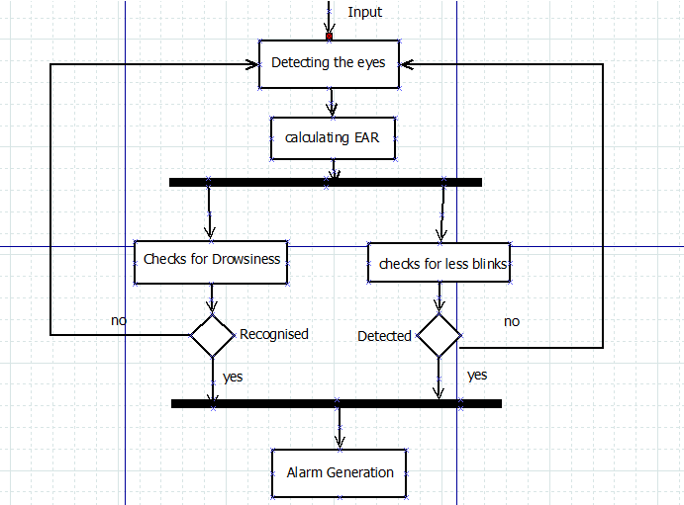
Data Flow Diagram

Slide 12
Implementation
Step 1: Taking input from the camera.
Step 2: Detecting the eyes & counting the blinks.
Step 3: If blink count < thresh, stage1 Alert.
Step 4: If blink count > thresh, GOTO step 2.
Step 5: Moving control to stage2, checking for drowsiness factor.
Step 6: If drowsiness factor > Standard drowsiness factor, give alert until eye’s are opened.
Step 7: If drowsiness factor < Standard drowsiness factor, GOTO Step 5.

Slide 13
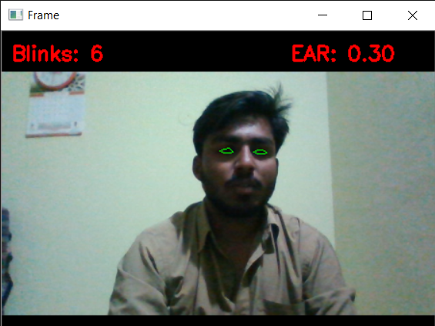
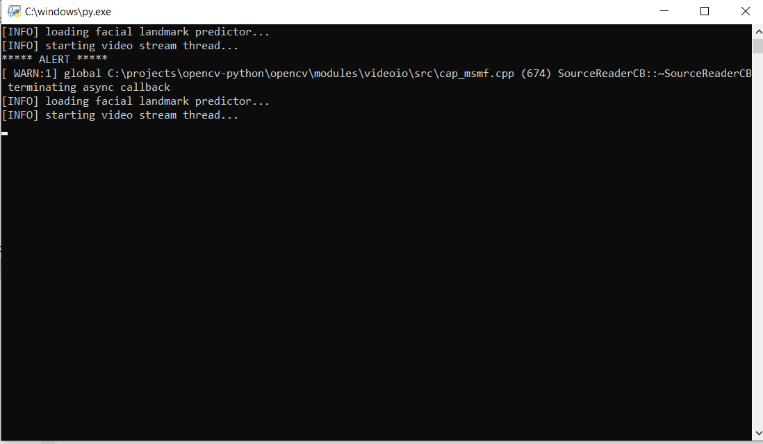
Outputs
The first stage of alerting will be like:

Slide 14
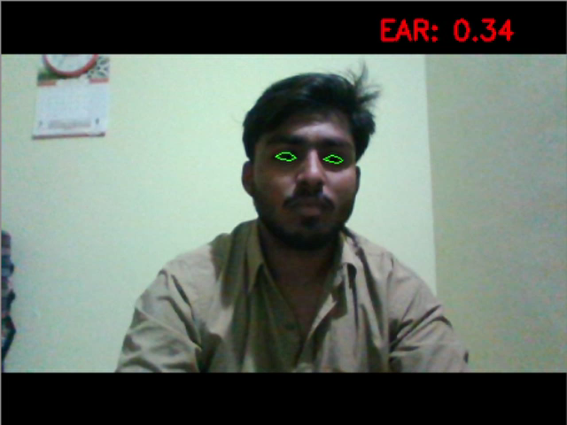
Contd..
The second stage of alert will be like

Slide 15
Conclusion
This application can be implemented in the real time to reduce traffic accidents rate.
It can also help drivers to stay awake while driving by giving a warning when the driver is sleepy.
It also alerts the driver if he blinks less number of times.

Slide 16
References
[1] N.Mathiarasi, T.Sureshkumar,”A Survey on Driver’s Drowsiness and Unconsciousness Detection Methodologies”,in International Journal of Engineering Development and Research,2014.
[2] Dr. Amitabh Wahi, Prof. S. Sundaramurthy, Ms P. Abinaya,”A Survey on Automatic Drowsy Driver Detection System in Image Processing”, in International Journal Of Innovative Science And Applied Engineering Research (IJISAER),2014.
[3] Omkar Dharmadhikari,Revati Bhor,Pranjal Mahajan,H.V. Kumbhar,”Survey on Driver’s Drowsiness Detection System”, International Journal of Computer Applications (0975 – 8887)Volume 132 – No.5, December 2015.

Slide 17
Thank you
Queries
?

